Slide 1
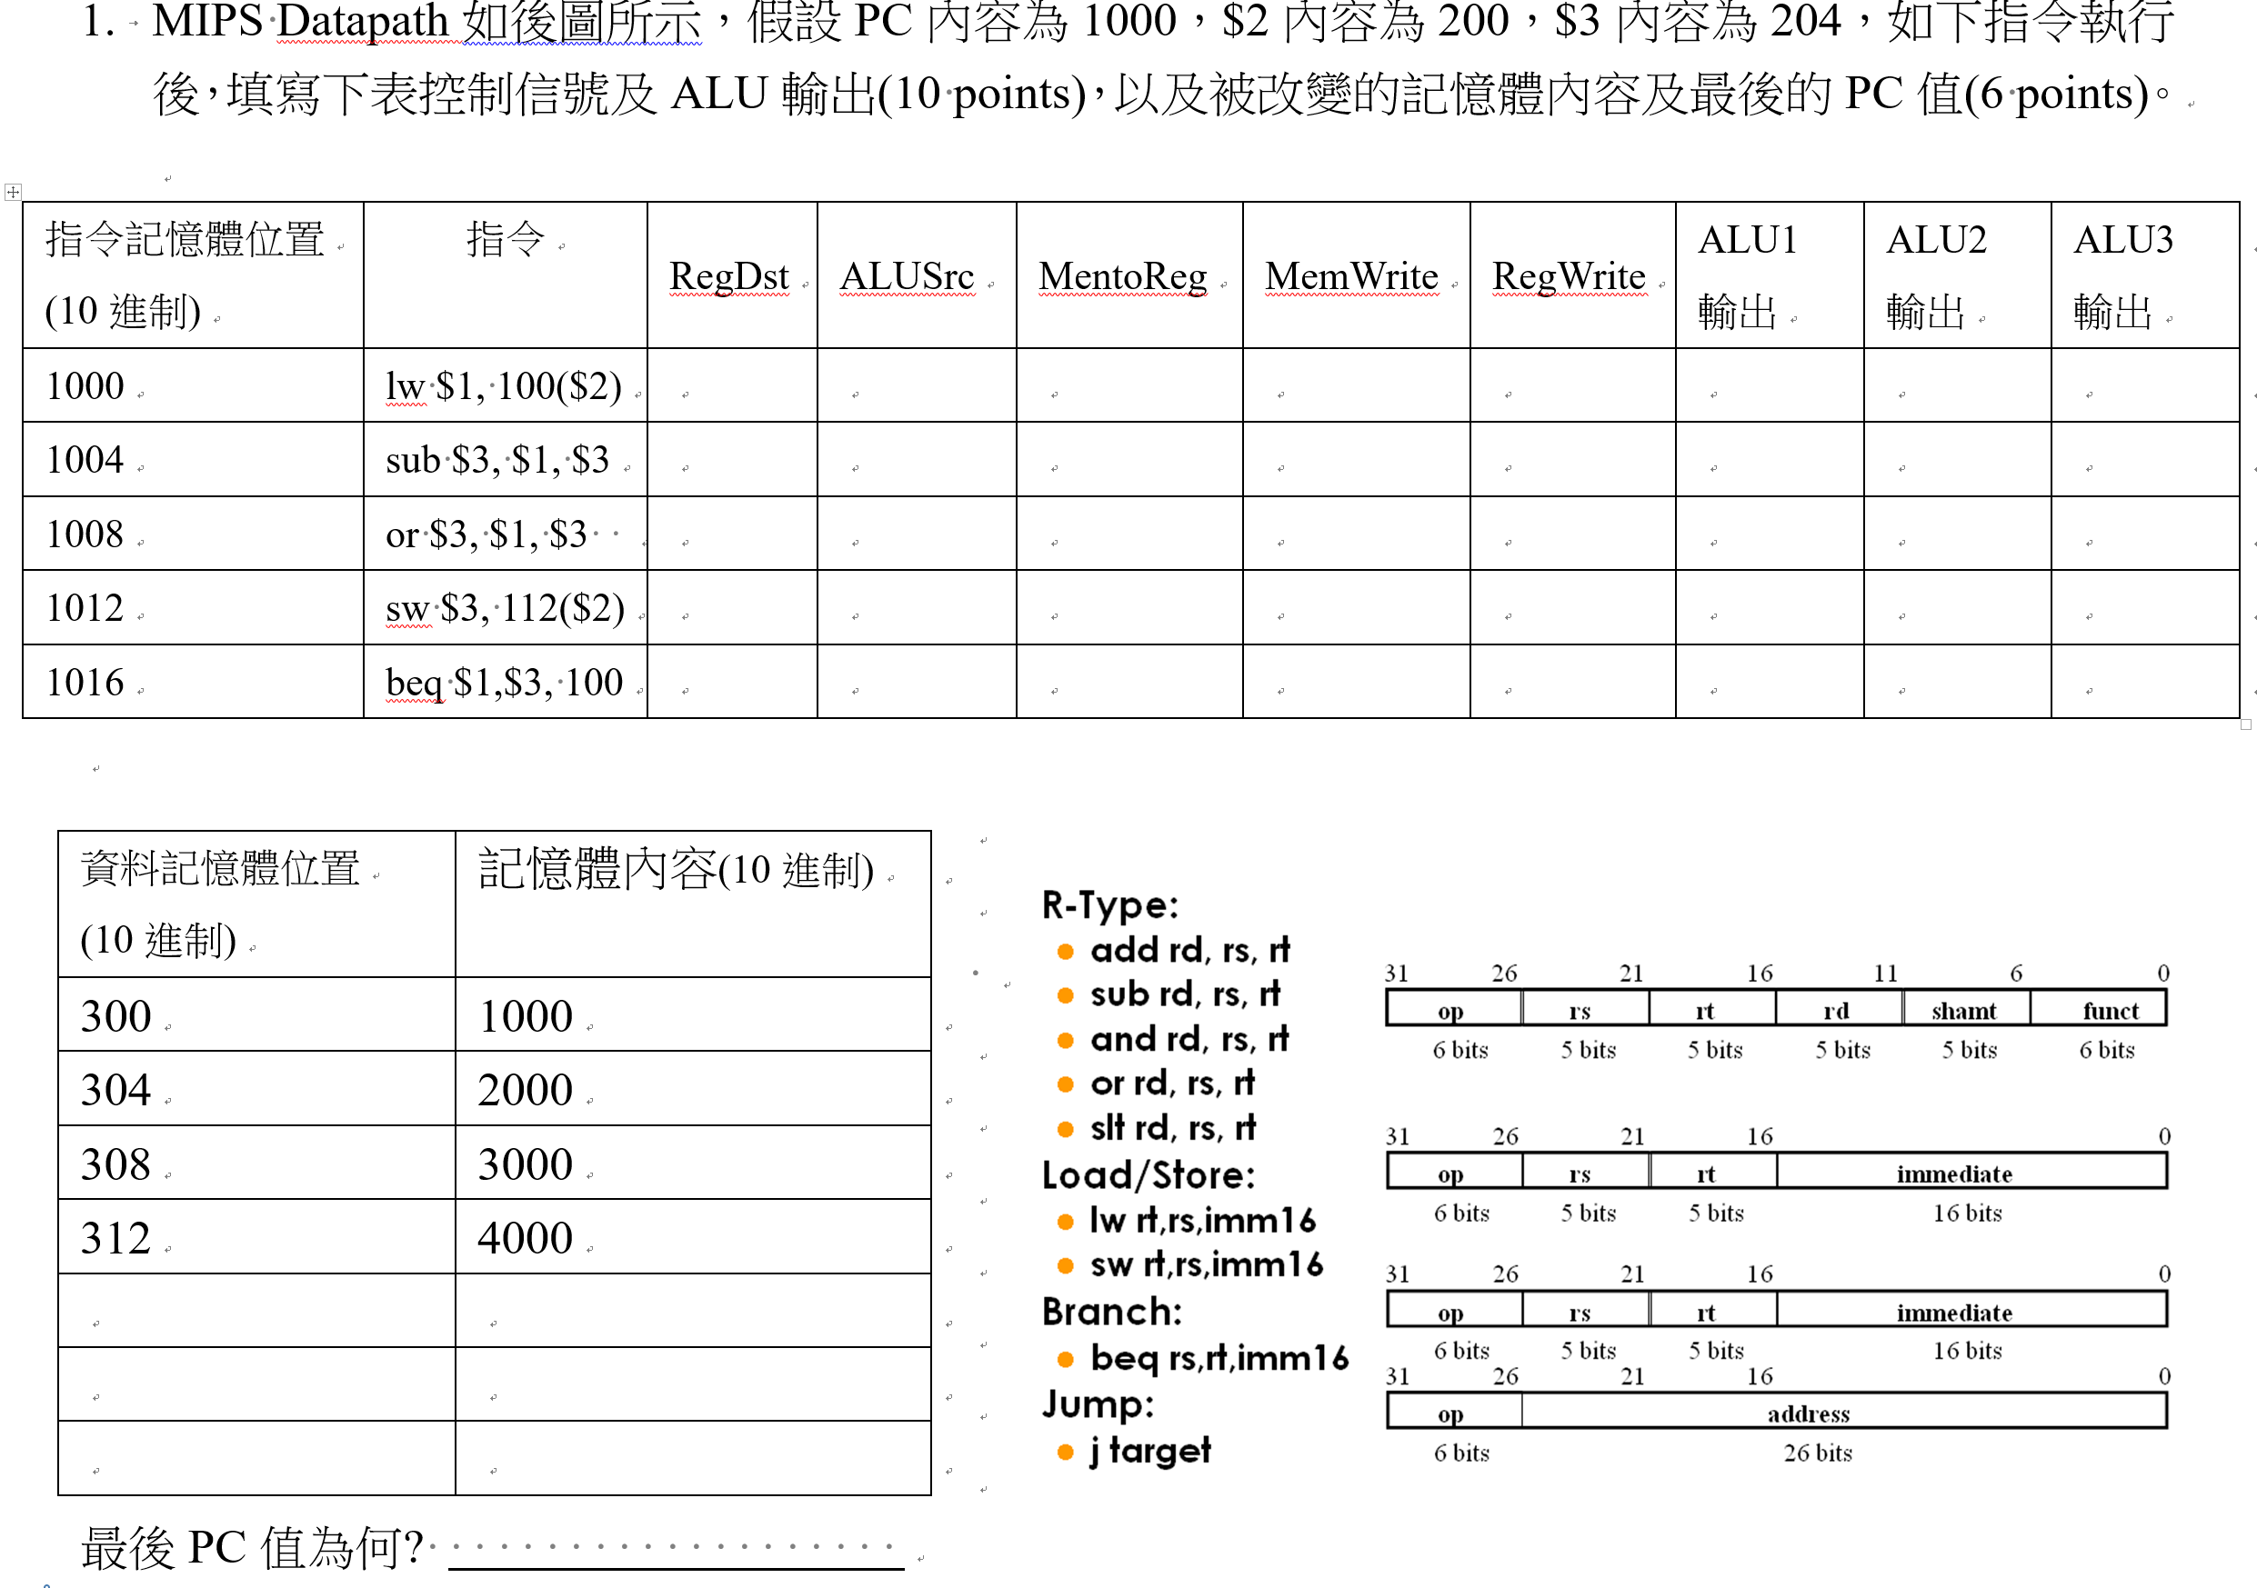

Slide 2
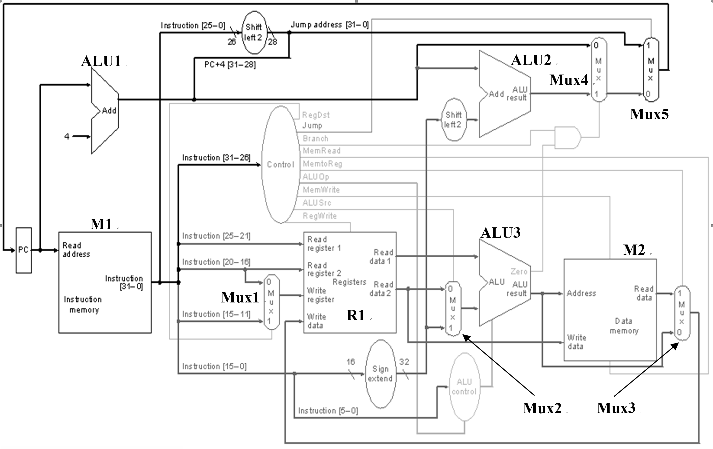

Slide 3
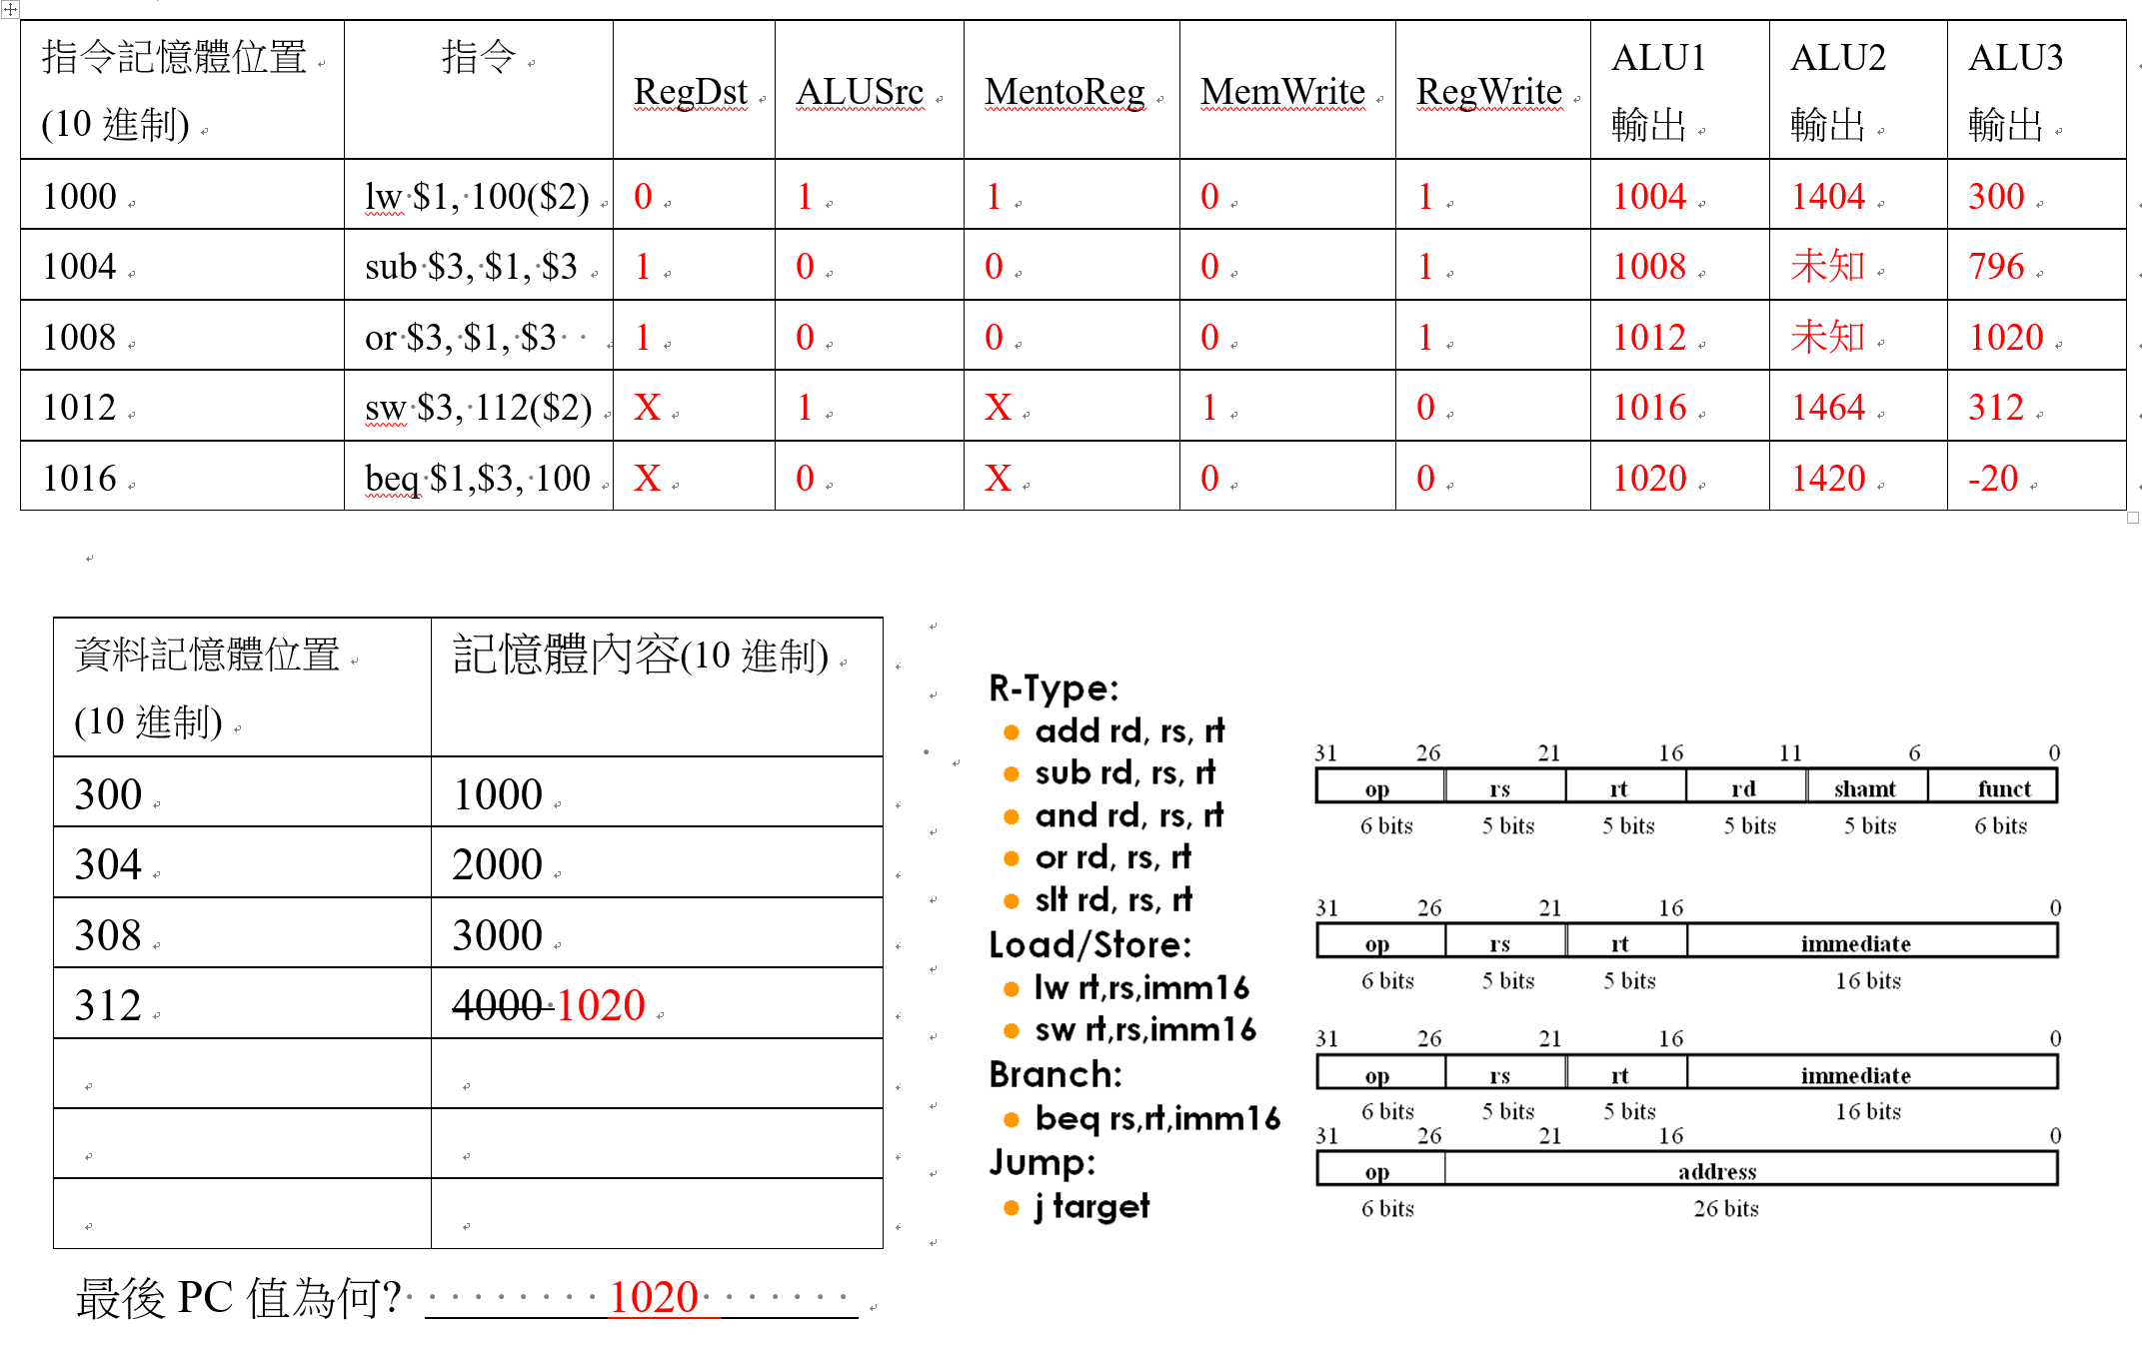

Slide 4
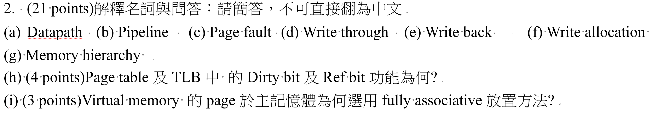

Slide 5
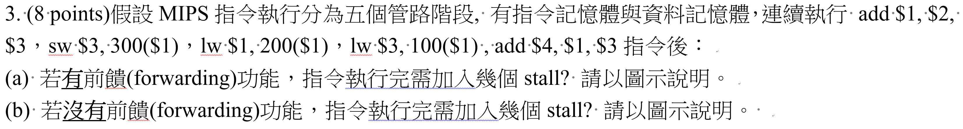

Slide 7
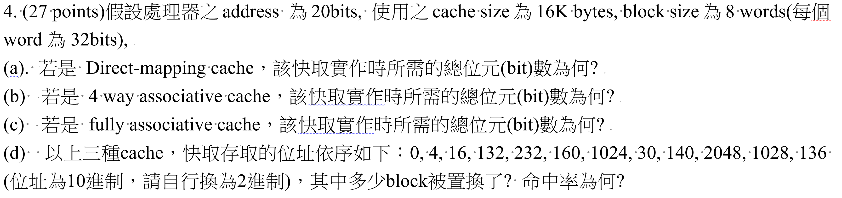

Slide 11
0, 4, 16, 132, 232, 160, 1024, 30, 140, 2048, 1028, 136
 | address |  | Hit/miss
0 | 00000000000000000000 |  | Miss
4 | 00000000000000000100 |  | Hit
16 | 00000000000000001000 |  | Hit
132 | 00000000000010000100 |  | Miss
232 | 00000000000011101000 |  | Miss
160 | 00000000000010100000 |  | Miss
1024 | 00000000010000000000 |  | miss
30 | 00000000000000011110 |  | hit
140 | 00000000000010001100 |  | hit
2048 | 00000000100000000000 |  | miss
1028 | 00000000010000000100 |  | hit
136 | 00000000000010001000 |  | hit
Direct-mapping cache：hit rate = 6/12

Slide 12
0, 4, 16, 132, 232, 160, 1024, 30, 140, 2048, 1028, 136
 | address |  |  |  |  | Hit/miss
0 | 00000000000000000000 |  |  |  |  | Miss
4 | 00000000000000000100 |  |  |  |  | Hit
16 | 00000000000000001000 |  |  |  |  | Hit
132 | 00000000000010000100 |  |  |  |  | Miss
232 | 00000000000011101000 |  |  |  |  | Miss
160 | 00000000000010100000 |  |  |  |  | Miss
1024 | 00000000010000000000 |  |  |  |  | miss
30 | 00000000000000011110 |  |  |  |  | hit
140 | 00000000000010001100 |  |  |  |  | hit
2048 | 00000000100000000000 |  |  |  |  | miss
1028 | 00000000010000000100 |  |  |  |  | hit
136 | 00000000000010001000 |  |  |  |  | hit
4 way associative cache：hit rate = 6/12

Slide 13
0, 4, 16, 132, 232, 160, 1024, 30, 140, 2048, 1028, 136
 | address |  |  |  |  | Hit/miss
0 | 00000000000000000000 |  |  |  |  | Miss
4 | 00000000000000000100 |  |  |  |  | Hit
16 | 00000000000000001000 |  |  |  |  | Hit
132 | 00000000000010000100 |  |  |  |  | Miss
232 | 00000000000011101000 |  |  |  |  | Miss
160 | 00000000000010100000 |  |  |  |  | Miss
1024 | 00000000010000000000 |  |  |  |  | miss
30 | 00000000000000011110 |  |  |  |  | hit
140 | 00000000000010001100 |  |  |  |  | hit
2048 | 00000000100000000000 |  |  |  |  | miss
1028 | 00000000010000000100 |  |  |  |  | hit
136 | 00000000000010001000 |  |  |  |  | hit
fully associative cache：hit rate = 6/12

Slide 14
0, 4, 16, 132, 232, 160, 16384, 30, 140, 2048, 1028, 136
 | address |  | Hit/miss
0 | 00000000000000000000 |  | Miss
4 | 00000000000000000100 |  | Hit
16 | 00000000000000001000 |  | Hit
132 | 00000000000010000100 |  | Miss
232 | 00000000000011101000 |  | Miss
160 | 00000000000010100000 |  | Miss
16384 | 00000100000000000000 |  | miss
30 | 00000000000000011110 |  | miss
140 | 00000000000010001100 |  | hit
2048 | 00000000100000000000 |  | miss
1028 | 00000000010000000100 |  | miss
136 | 00000000000010001000 |  | hit
Direct-mapping cache：hit rate = 4/12

Slide 15
0, 4, 16, 132, 232, 160, 16384, 30, 140, 2048, 1028, 136
 | address |  |  |  |  | Hit/miss
0 | 00000000000000000000 |  |  |  |  | Miss
4 | 00000000000000000100 |  |  |  |  | Hit
16 | 00000000000000001000 |  |  |  |  | Hit
132 | 00000000000010000100 |  |  |  |  | Miss
232 | 00000000000011101000 |  |  |  |  | Miss
160 | 00000000000010100000 |  |  |  |  | Miss
16384 | 00000100000000000000 |  |  |  |  | miss
30 | 00000000000000011110 |  |  |  |  | hit
140 | 00000000000010001100 |  |  |  |  | hit
2048 | 00000000100000000000 |  |  |  |  | miss
1028 | 00000000010000000100 |  |  |  |  | miss
136 | 00000000000010001000 |  |  |  |  | hit
4 way associative cache：hit rate = 5/12

Slide 16
0, 4, 16, 132, 232, 160, 16384, 30, 140, 2048, 1028, 136
 | address |  |  |  |  | Hit/miss
0 | 00000000000000000000 |  |  |  |  | Miss
4 | 00000000000000000100 |  |  |  |  | Hit
16 | 00000000000000001000 |  |  |  |  | Hit
132 | 00000000000010000100 |  |  |  |  | Miss
232 | 00000000000011101000 |  |  |  |  | Miss
160 | 00000000000010100000 |  |  |  |  | Miss
16384 | 00000100000000000000 |  |  |  |  | miss
30 | 00000000000000011110 |  |  |  |  | hit
140 | 00000000000010001100 |  |  |  |  | hit
2048 | 00000000100000000000 |  |  |  |  | miss
1028 | 00000000010000000100 |  |  |  |  | hit
136 | 00000000000010001000 |  |  |  |  | hit
fully associative cache：hit rate = 6/12

Slide 17
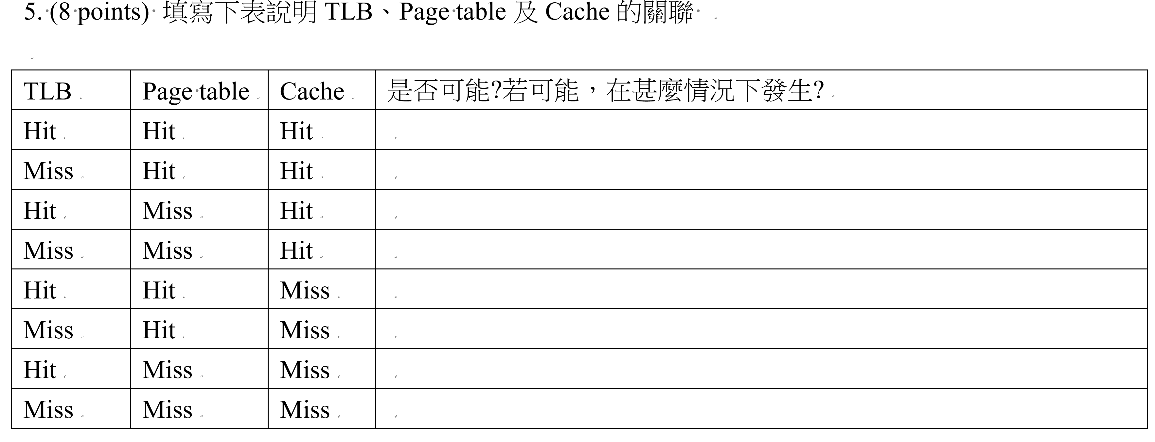

Slide 18
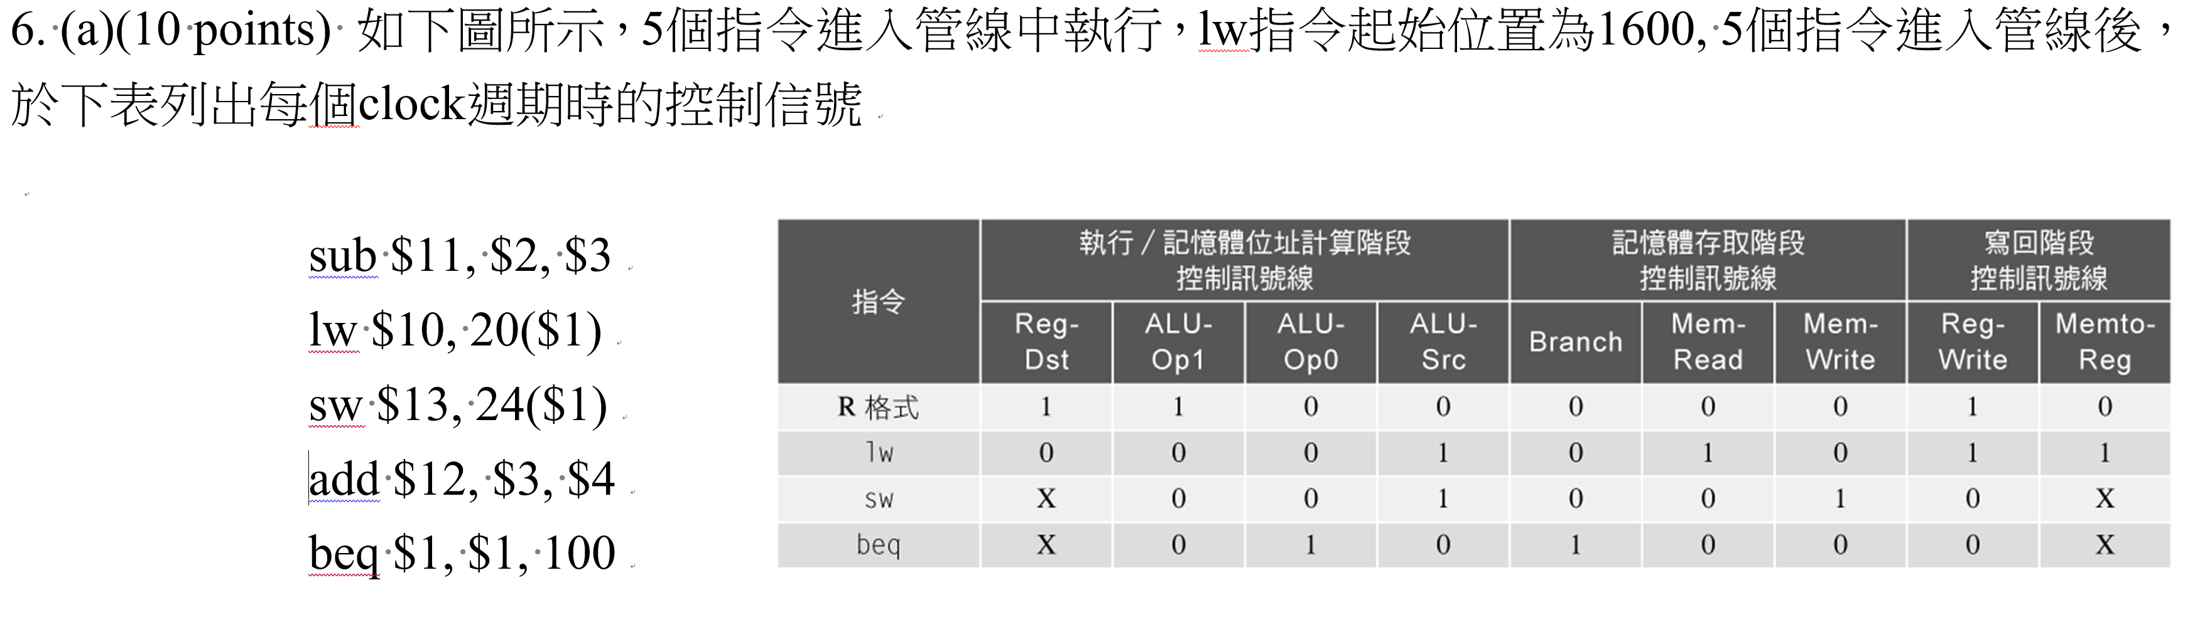

Slide 19
Clcok | 1 | 2 | 3 | 4 | 5 | 6 | 7 | 8 | 9
 | sub IF | sub ID | sub ex | sub Mem | sub wr
 |  | Lw IF | Lw ID | Lw ex | Lw Mem | Lw wr
 |  |  | sw IF | sw ID | sw ex | sw Mem | sw wr
 |  |  |  | add IF | add ID | add ex | add Mem | add wr
 |  |  |  |  | beq IF | beq ID | beq ex | beq Mem | beq wr
Clcok | 1 | 2 | 3 | 4 | 5 | 6 | 7 | 8 | 9
RegDst |  |  | 1 | 0 | X | 1 | X
ALUSrc |  |  | 0 | 1 | 1 | 0 | 0
MemRead |  |  |  | 0 | 1 | 0 | 0 | 0
MemWrite |  |  |  | 0 | 0 | 1 | 0 | 0
RegWrite |  |  |  |  | 1 | 1 | 0 | 1 | 0
MemtoReg |  |  |  |  | 0 | 1 | X | 0 | X

Slide 20
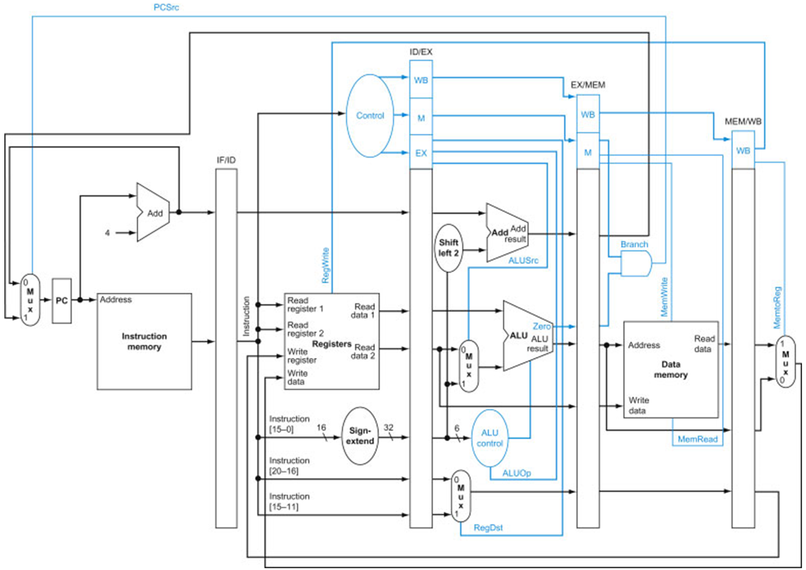

Slide 21
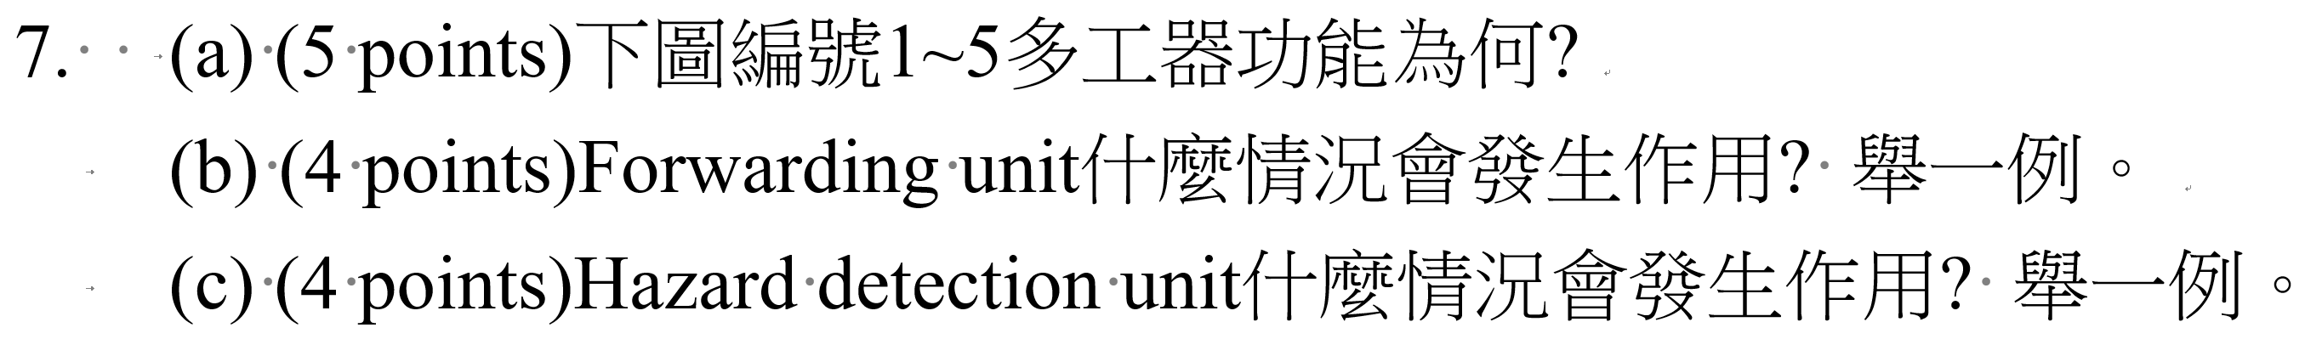

Slide 22
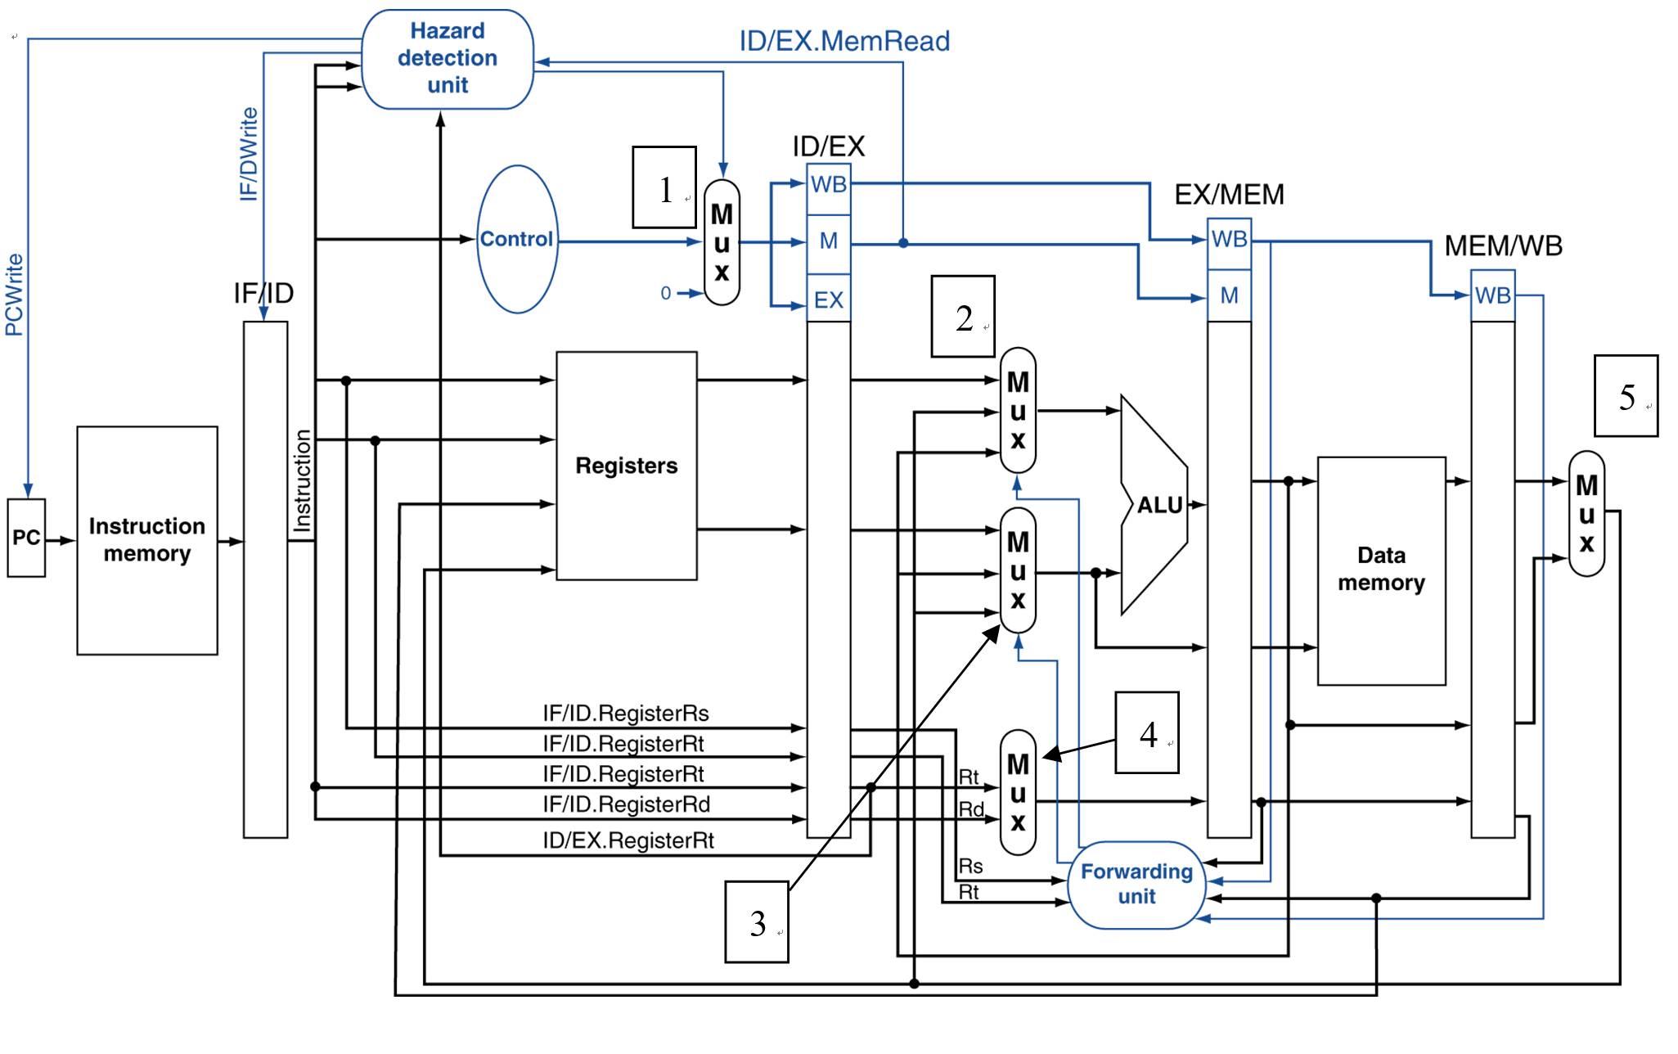

Slide 23
